Slide 1
API 202 Section #4
TF: Kelsey Pukelis
2023-02-17

Slide 2
Outline
When to use causal language
Experiment scenarios
Non-linear regression

Slide 3
When to use causal language

Slide 4
Examples of causal language vs. not
Causal language
Causes
Causal relationship
X decreases/increases Y
Any action verb
Effect of X on Y
Influences (somewhere in between, I would recommend avoiding for this class)
Not causal language
Is associated with
Relationship between
Correlated with

Slide 5
Notes about causal language
Determining whether something is causal or not is more about our assumptions about the setting and speculations about the relationships between variables in the population…
…rather than output from regressions using sample data
Why is this incorrect?
"Yes, here the p value is 0.0218 which is less than 0.05 making it statistically significant at 5% level. Hence, we can conclude there is a causal relationship."

Slide 6
Tip: avoid causal language UNLESS
We are describing a relationship of a policy question we are interested in answering, which is often causal
i.e. if we changed our policy on X, would it affect an outcome Y?
Even though we may not be able to answer the question using data

Slide 7
Tip: avoid causal language UNLESS we have evidence from:
We have evidence from a regression where we think we have controlled for all possible important omitted variables
We may or may not be convinced of this, depending on the setting + data available
an experiment
a natural experiment that we are convinced by
If you stick with Professor Michela Carlana’s next module, you will cover this

Slide 8
Experiments
Some materials drawn from JPAL: https://www.povertyactionlab.org/research-resources

Slide 9
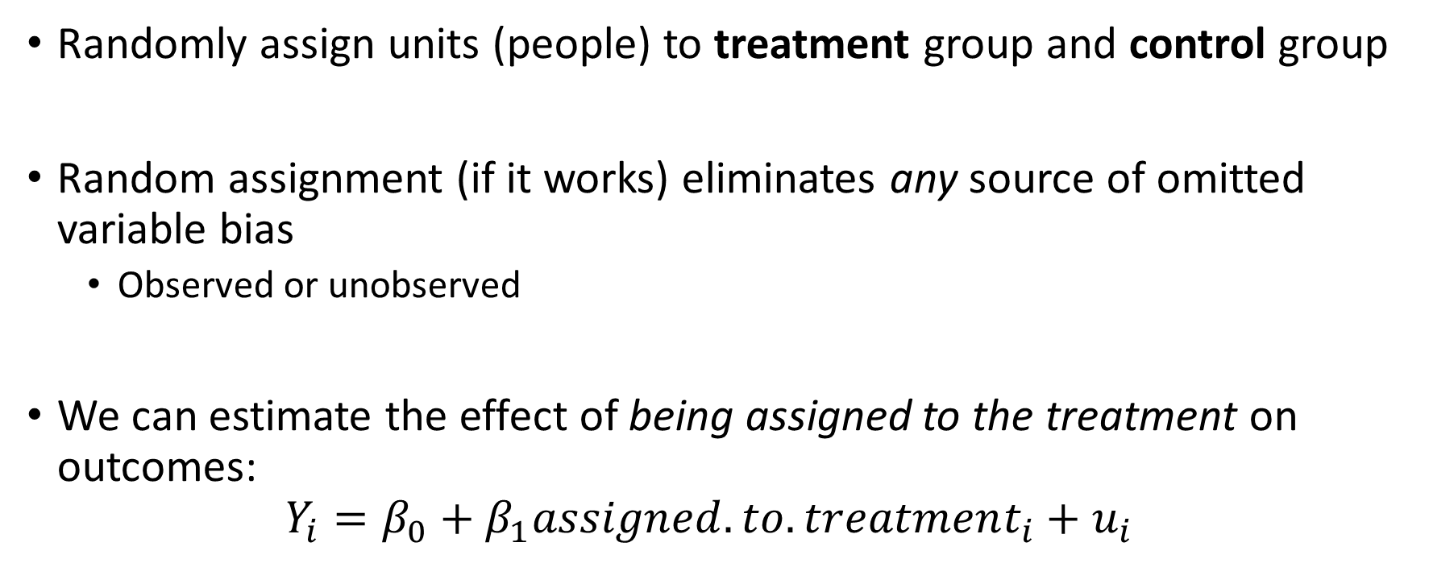
Experiments review
Randomly assign units (people) to treatment group and control group
Random assignment (if it works) eliminates any source of omitted variable bias
Observed or unobserved
We can estimate the effect of being assigned to the treatment on outcomes:
$$Y_{i}=β_{0}+β_{1}assigned.to.treatment_{i}+u_{i}$$

Slide 10
Experiment topics
Non-compliance
Spillovers
Attrition

Slide 11
Non-compliance

Slide 12
What is compliance?
 | Actual Participation (possibly non-random)
Random Assignment |  | Actually participates in control group (e.g. participates in a regular class) | Actually participates in treatment group (e.g. participates in a regular class)
Assignment | Assigned to control group (e.g. assigned to regular class) | Compliance (“non-participants”) | Non-compliance (“crossovers”)
 | Assigned to treatment group (e.g. assigned to small class) | Non-compliance (“no-shows”) | Compliance (“participants”)
Note: The structure from this table is different from the lecture notes table!

Slide 13
Why might non-compliance occur?
Non-compliance could arise if factors other than random assignment influence program allocation
Can be due to project implementers or to participants themselves
Why does this matter?
Non-compliance “messes with randomness”, which is the whole reason we ran the experiment in the first place!!
If we don’t analyze the data properly, we are back to the same issues as before!!! (e.g. omitted variable bias)

Slide 14
How could OVB reappear?
Say we ran the Tennessee STAR experiment, randomly assigning class size and studying effects on students’ test scores.
Suppose some students assigned to regular classes switch into small classes because their involved parents make calls to the school principal to get them switched.
Say we go on to analyze the experiment comparing students who are actually in small classes to those actually in regular classes.
How does this reintroduce omitted variable bias?

Slide 15
How could OVB reappear?
How does this reintroduce omitted variable bias?
If we analyze the experiment comparing students who are actually in small classes to those actually in regular classes, then we are reintroducing an omitted variable (parental involvement or parental income) back into our analysis, which is likely to bias our results.
(See section recording for a walk-through of signing the bias in this case.)

Slide 16
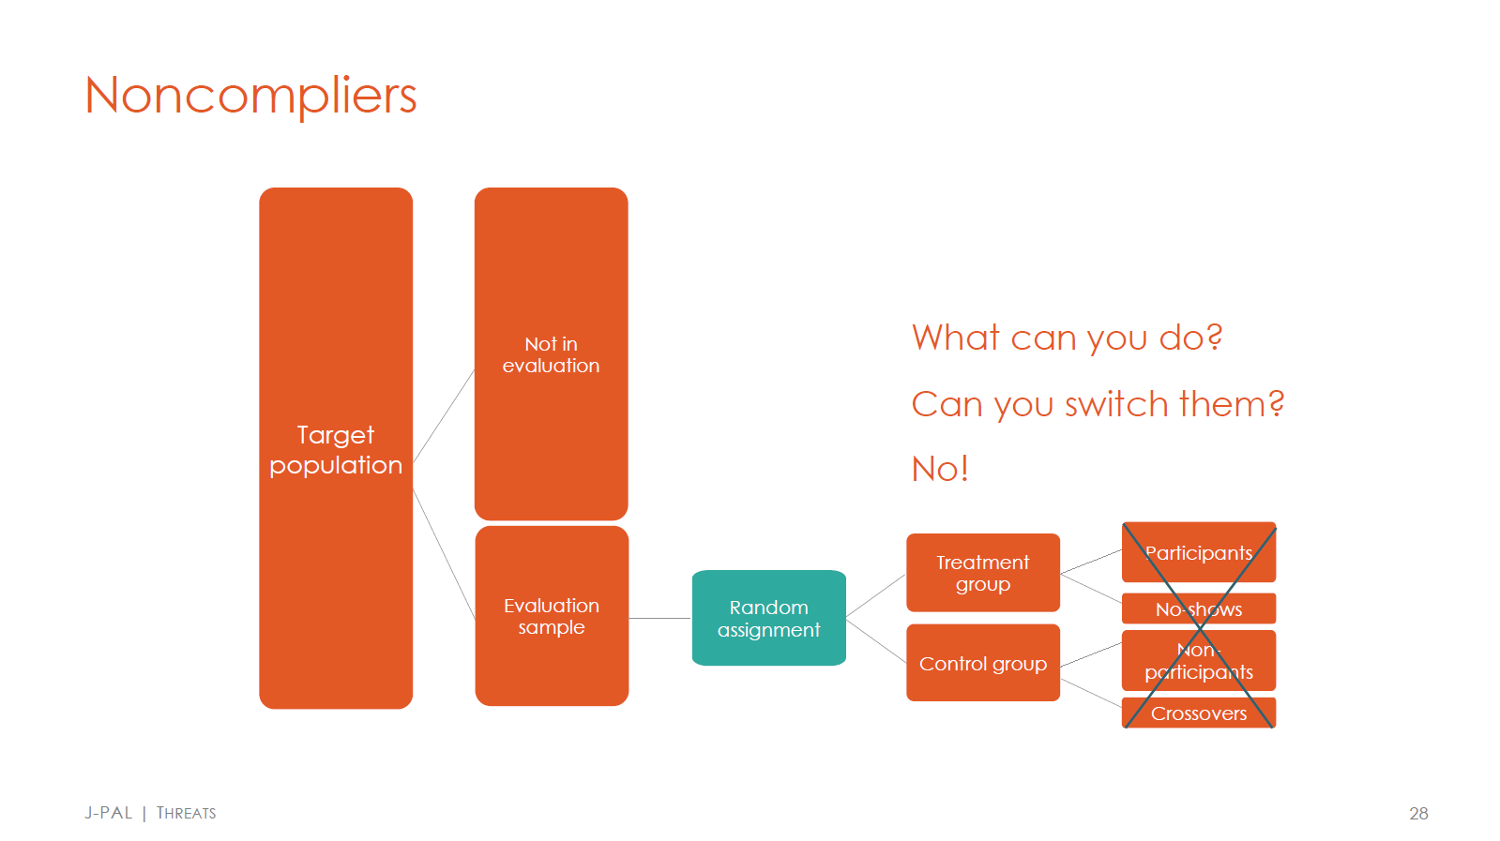

Slide 17


Slide 18
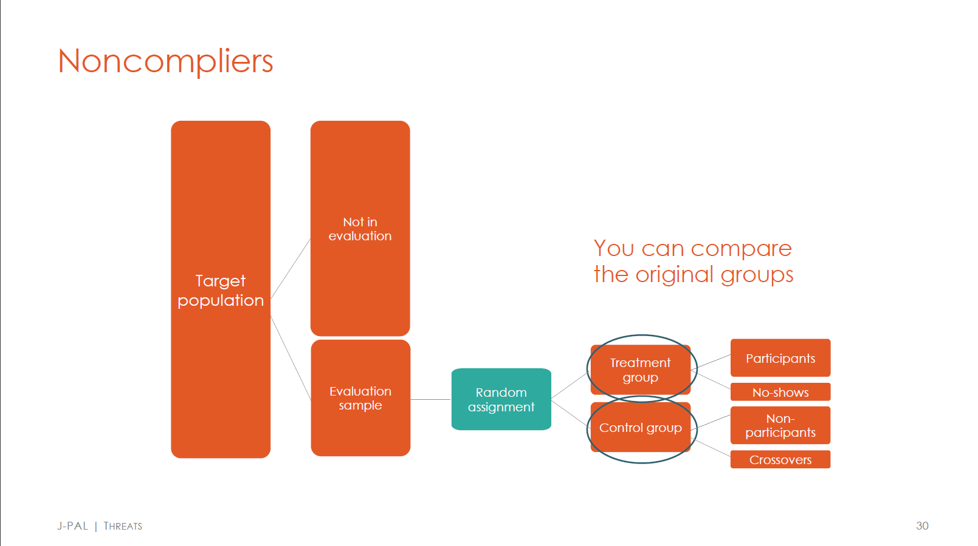

Slide 19
Assuming randomization “worked”…
…we can [never / sometimes / always] learn the causal effect of being assigned to treatment.
…we can [never / sometimes / always] learn the causal effect of the treatment itself.

Slide 20
Assuming randomization “worked”…
…we can [never / sometimes / always] learn the causal effect of being assigned to treatment.
Always. Assuming randomization worked, we randomly assigned units (people) to treatment or control groups, so we can always study random assignment, even if people did not perfectly comply. This is called the “Intent to Treat” (ITT) effect.

Slide 21
Assuming randomization “worked”…
…we can [never / sometimes / always] learn the causal effect of the treatment itself.
Sometimes.
If there is perfect compliance, we can analyze the effect of the actual treatment. In this case, this is the same as analyzing the effect of being assigned to treatment.
Under certain assumptions, even if there is imperfect compliance, we can analyze the effect of the actual treatment (outside the scope of this course)

Slide 22
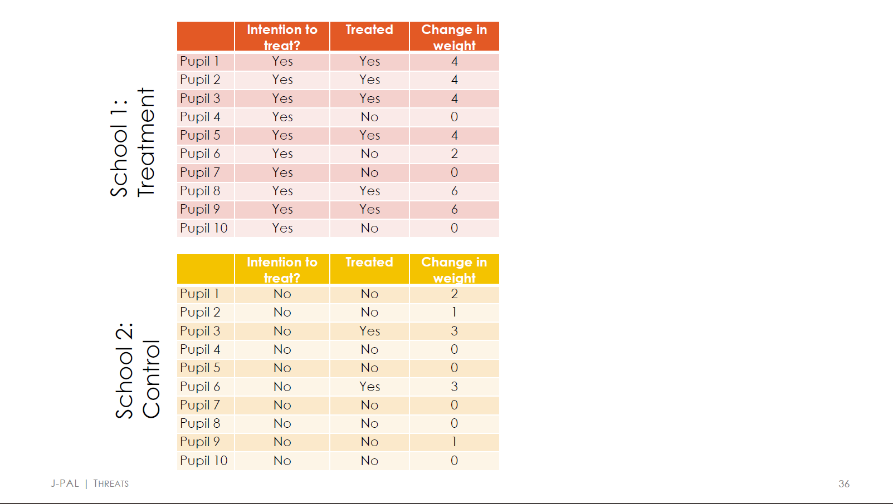

Slide 23
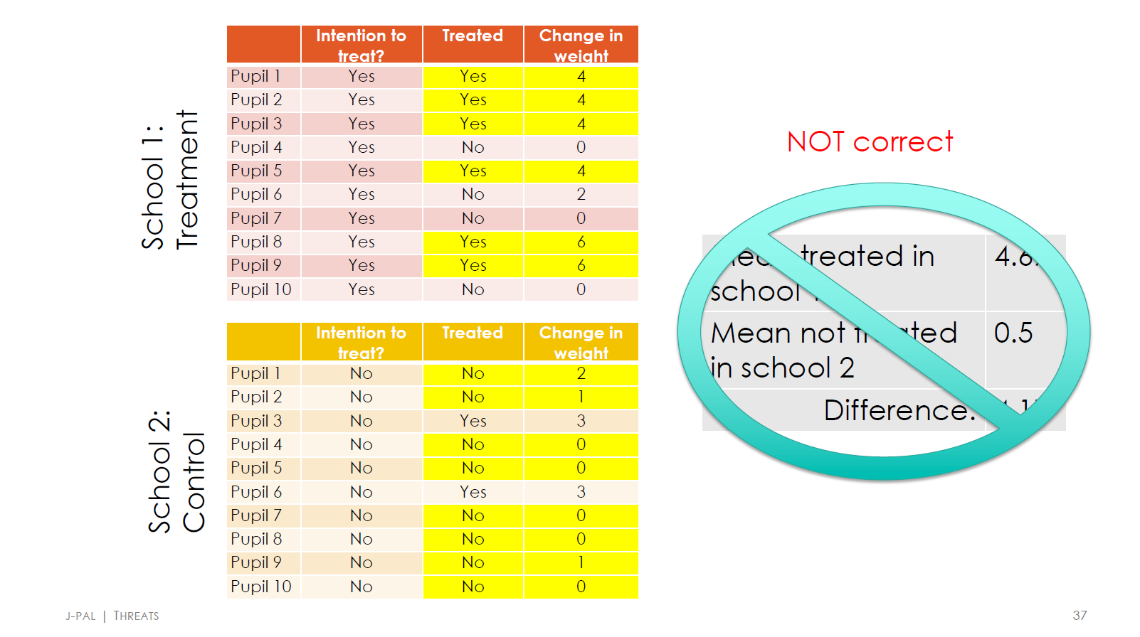

Slide 24
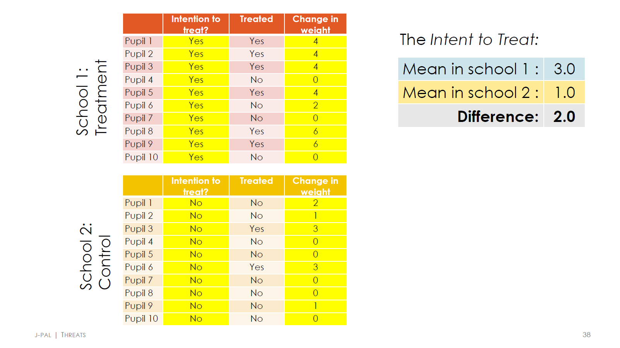

Slide 25
Which is the policy-relevant parameter?
The causal effect of being assigned to treatment OR the causal effect of the treatment itself?
Consider the context of randomizing a deworming treatment program across schools.

Slide 26
Which is the policy-relevant parameter?
The causal effect of being assigned to treatment OR the causal effect of the treatment itself?
Consider the context of randomizing a deworming treatment program across schools.
It depends!
The causal effect of the treatment itself = the medical effect of a deworming treatment
However, we may not be interested in the medical effect of deworming treatment, but instead what would happen under an actual deworming program.
If students often miss school and therefore don't get the deworming medicine, the intention to treat estimate may actually be most relevant.

Slide 27
Spillovers

Slide 28
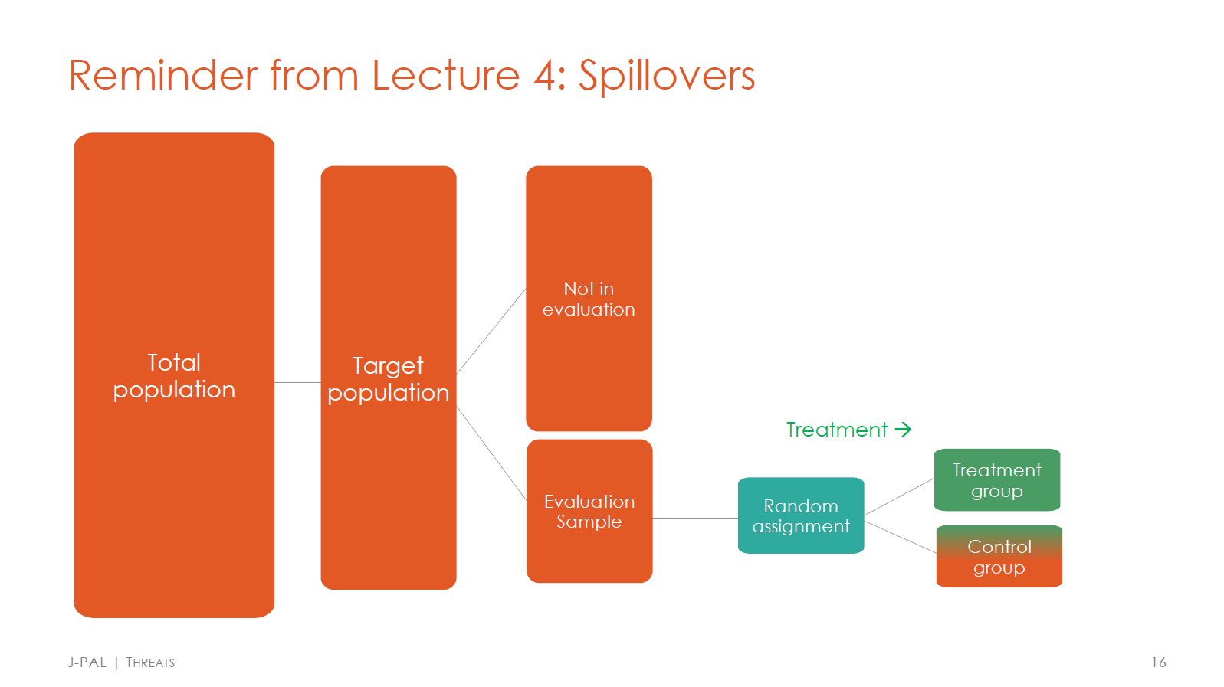

Slide 29
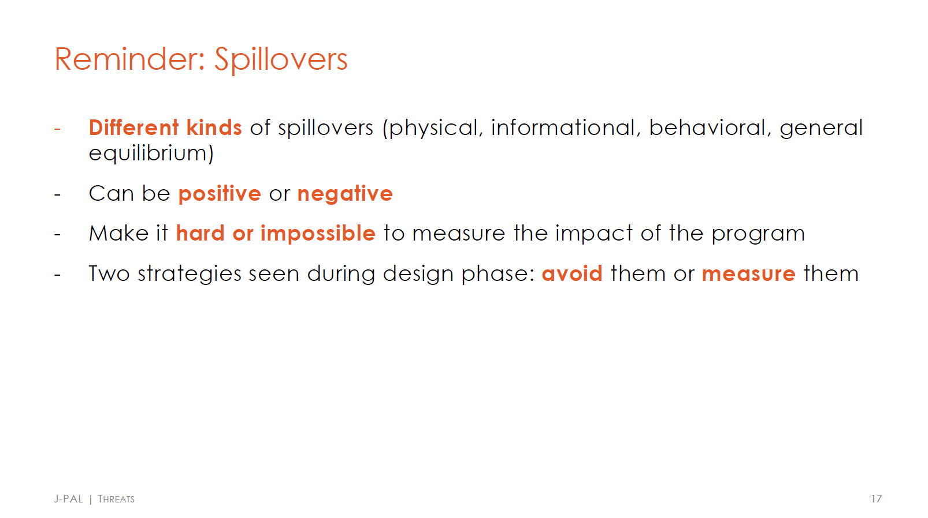

Slide 30
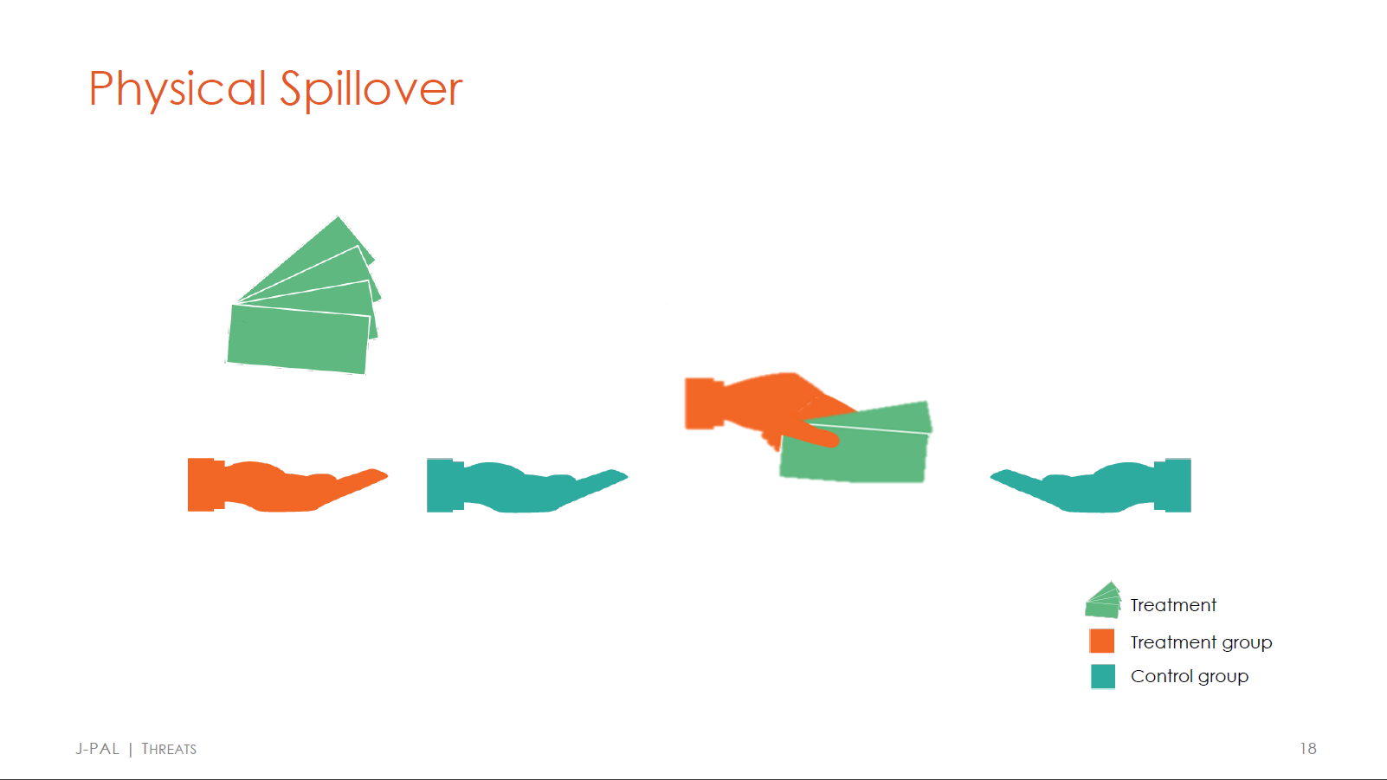

Slide 31
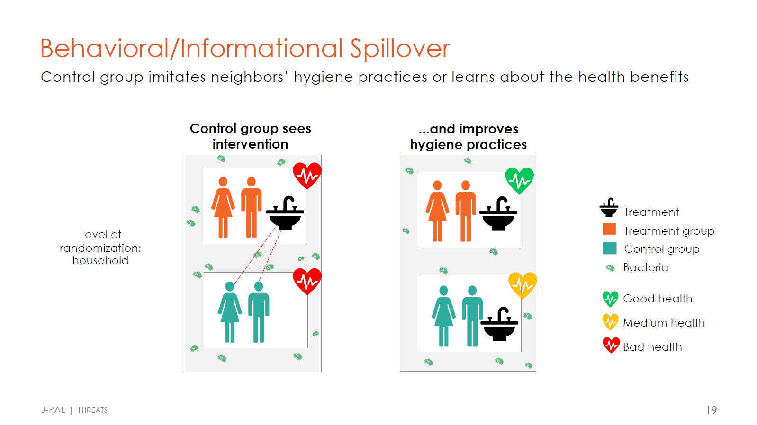

Slide 32
Check for understanding
In the last slide, if we ignored spillovers, we would [overestimate / underestimate] the true effect of the hygiene program on health.

Slide 33
Check for understanding
In the last slide, if we ignored spillovers, we would [overestimate / underestimate] the true effect of the hygiene program on health.
Underestimate. The true effect of the hygiene program is the difference between the treated group (which has good health) and an “untainted” control group (which has bad health). With spillovers, however, the control group is actually somewhat treated (so has medium health). So, if we ignored spillovers, we would measure the impact of the treatment as the difference between good health and medium health, which is an underestimate of the true difference.

Slide 34
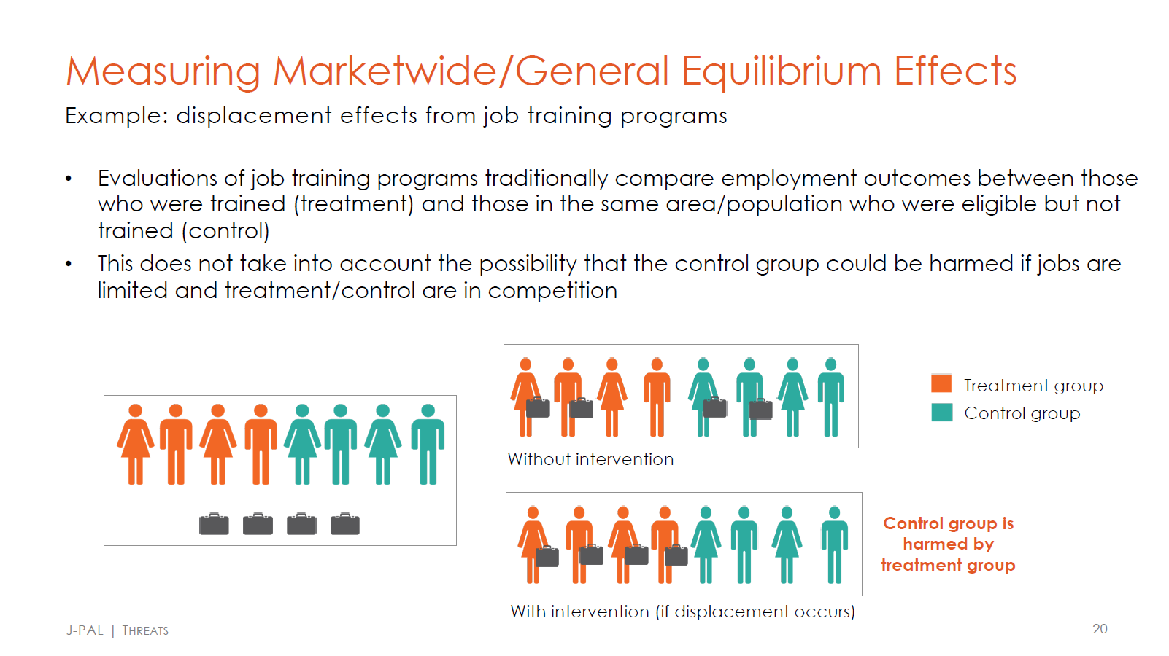

Slide 35
Check for understanding
In the last slide, if we ignored spillovers, we would [overestimate / underestimate] the true effect of the job training program on employment.

Slide 36
Check for understanding
In the last slide, if we ignored spillovers, we would [overestimate / underestimate] the true effect of the job training program on employment.
Overestimate. The job training program increases the job prospects of some treated individuals at the expense of individuals in the control group. The intervention displaces the jobs from some control individuals to some treated individuals. If we only saw data from the world with the intervention, we would conclude the training program’s effect on employment was higher than the true effect (overestimate).

Slide 37
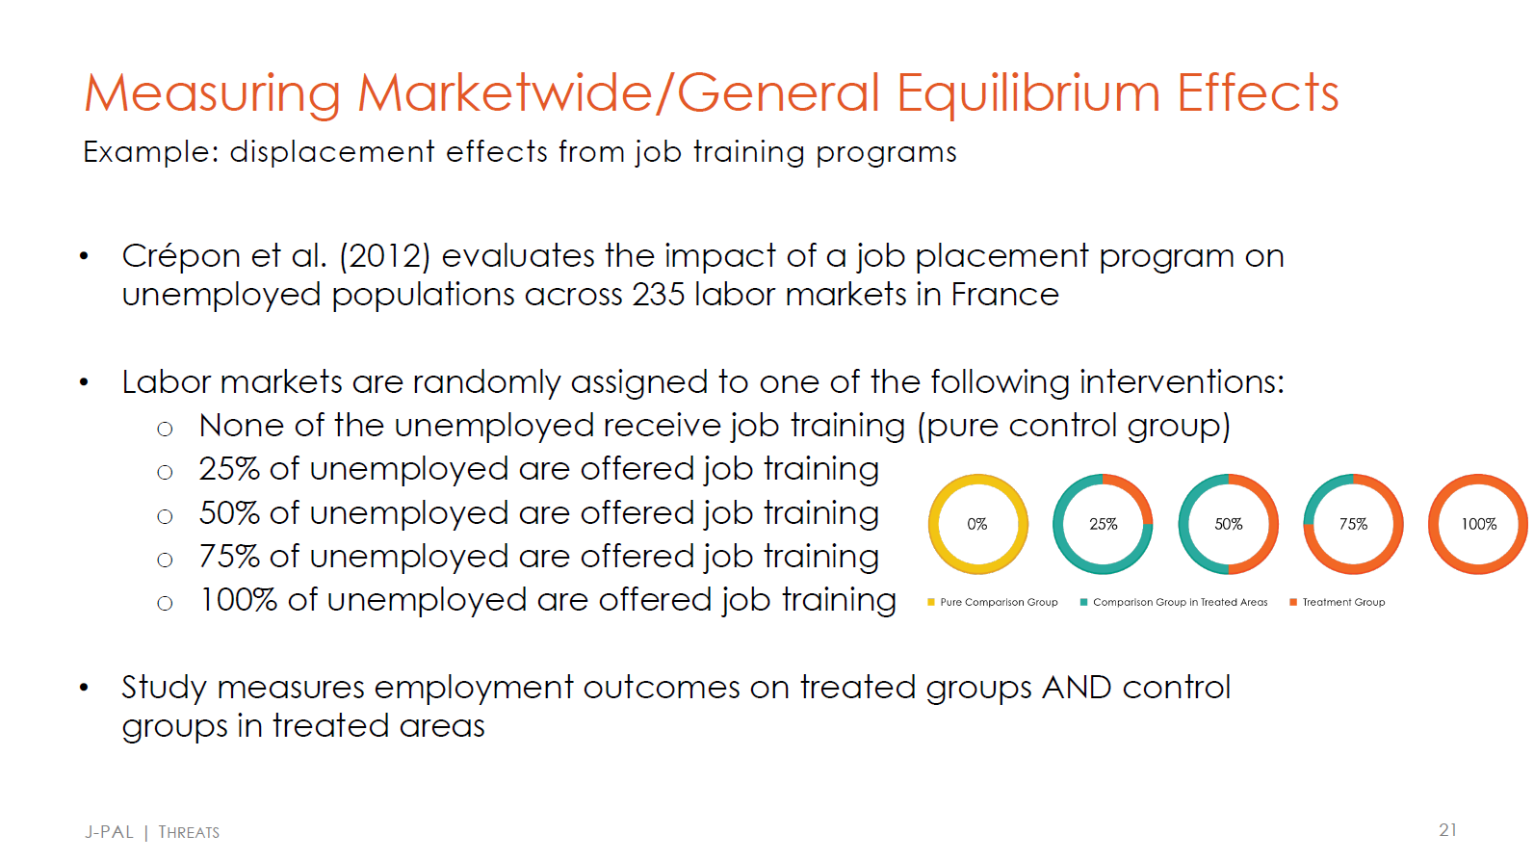
Extra slide if you’re curious, but is outside the scope of this class.

Slide 38
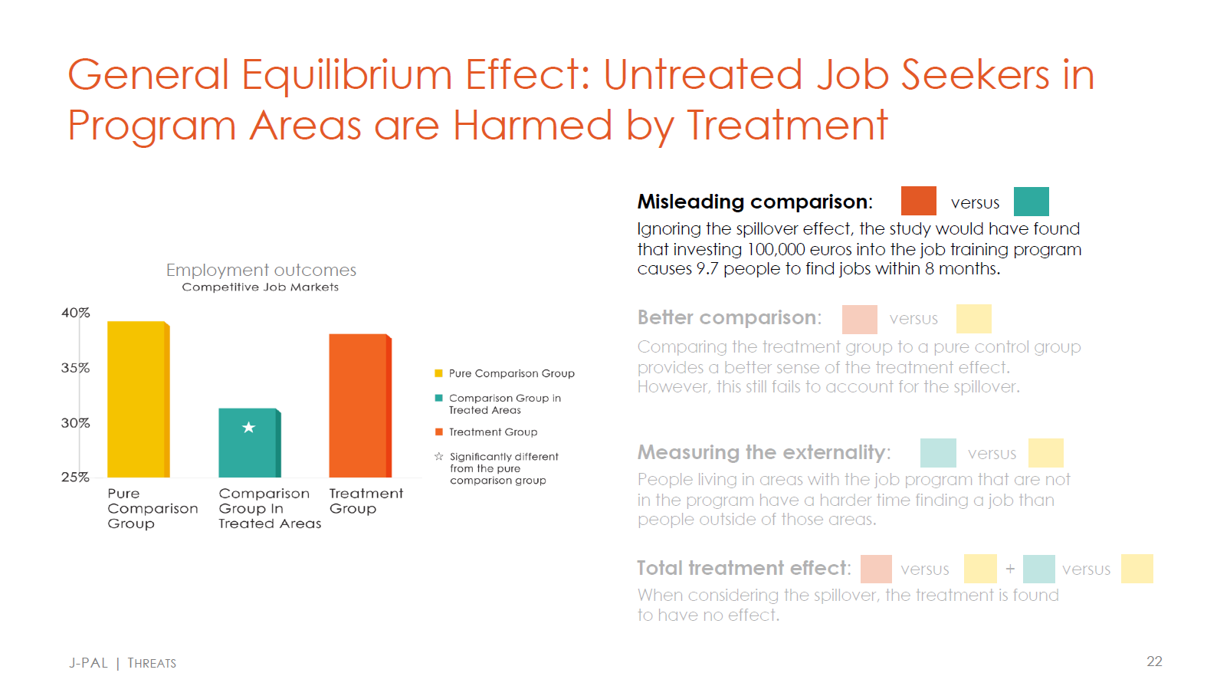
Extra slide if you’re curious, but is outside the scope of this class.

Slide 39
Can you think of an example of a spillover?
In the context of a school tutoring program?
In the context of the Oregon Health Insurance Experiment?
In the context of an agricultural fertilizer program?

Slide 40
Can you think of an example of a spillover?
In the context of a school tutoring program?
This is an example of a likely informational/behavioral spillover. If you tutor some children in a school, and the students help each other learn in or outside the classroom, then there could be positive spillovers. In particular, spillovers from tutored children onto children not enrolled in the tutoring program.
In the context of the Oregon Health Insurance Experiment?
This is an example of a possible general equilibrium or displacement spillover. Recall that providing insurance was found to increase utilization of the emergency room. If emergency rooms were constrained, and newly insured patients took the place of existing patients, then we might overestimate the effects of the health insurance offer on health outcomes. (Admittedly this is a bit of a stretch.)
In the context of an agricultural fertilizer program?
This is an example of a literal physical spillover, if fertilizer from one farmer’s land blows onto another farmer’s land.

Slide 41
Attrition

Slide 42
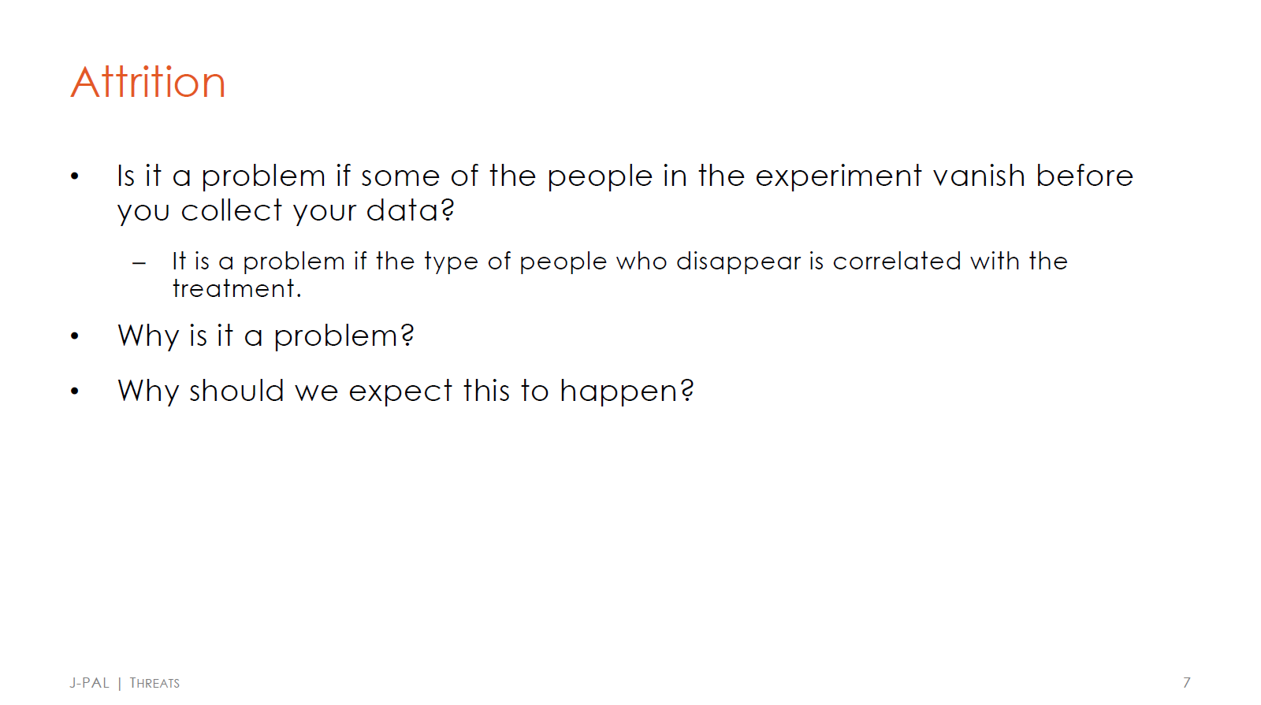

Slide 43
Typical settings where attrition is an issue
Multiple rounds of surveys
Where people drop out of a program/school, and there is no administrative data on them afterwards
Geographic mobility or death

Slide 44
Attrition example
Suppose we were interested in the effect of a war draft on health outcomes in old age.
What might be an attrition issue in this context?

Slide 45
Attrition example
Suppose we were interested in the effect of a war draft on health outcomes in old age.
What might be an attrition issue in this context?
If individuals who are drafted are also more likely to pass away earlier on in life, than we would not be able to observe their health outcomes in old age.
If we instead were interested in mortality earlier on in life directly, and we could observe this for all people in our study, then attrition would not be an issue.

Slide 46
Non-linear regression
See Google Collab link

